Slide 1
THG Simulations
Project update
Week 3
09/08/2023
David Amorim

Slide 2
Outline
Saturation
Effect of beam power
Effect of ionisation
Effect of CEO phase
Spectral peaks
Beam shape
Self-steepening

Slide 3
Saturation was achieved!!!
Show spectra!!! -> show sample run again ??
Analyse breaking points in detail!
Compare to measured data!
USE MORE NEON PLOTS????!!!

Slide 4
I. SATURATION

Slide 5
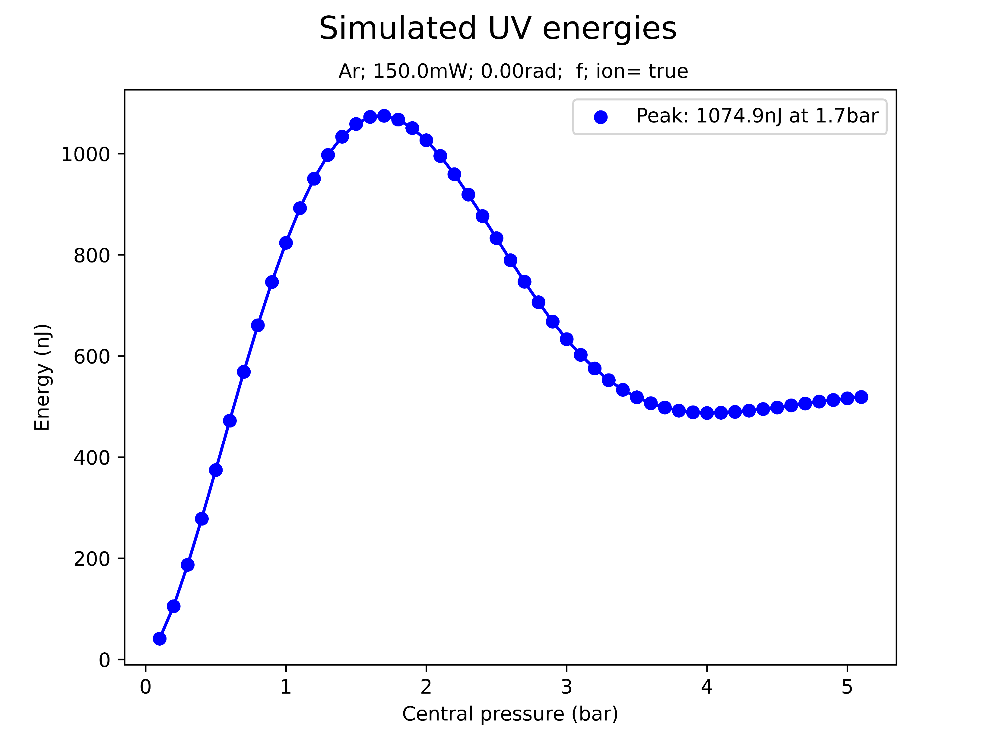
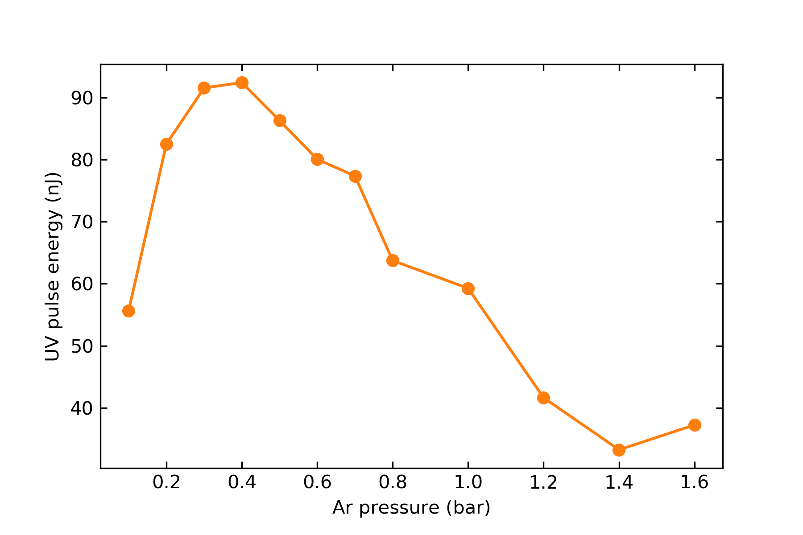
Saturation
simulated
At sufficiently high pressures, the simulation predicts a saturation in the UV energy
Qualitatively, this agrees with experiments
However, simulated saturation energies and pressures are much higher!
measured (same params)

Slide 6
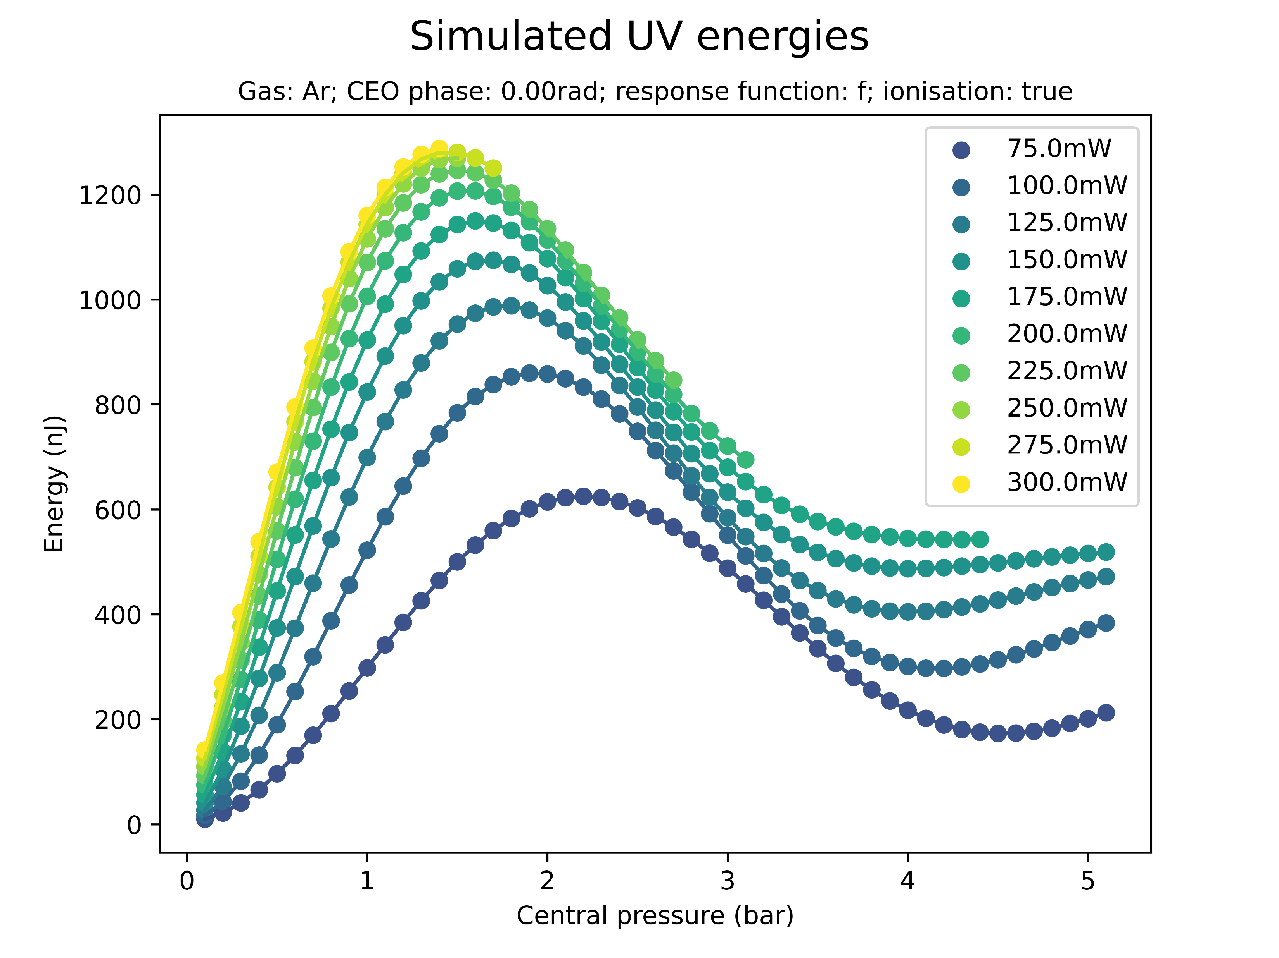
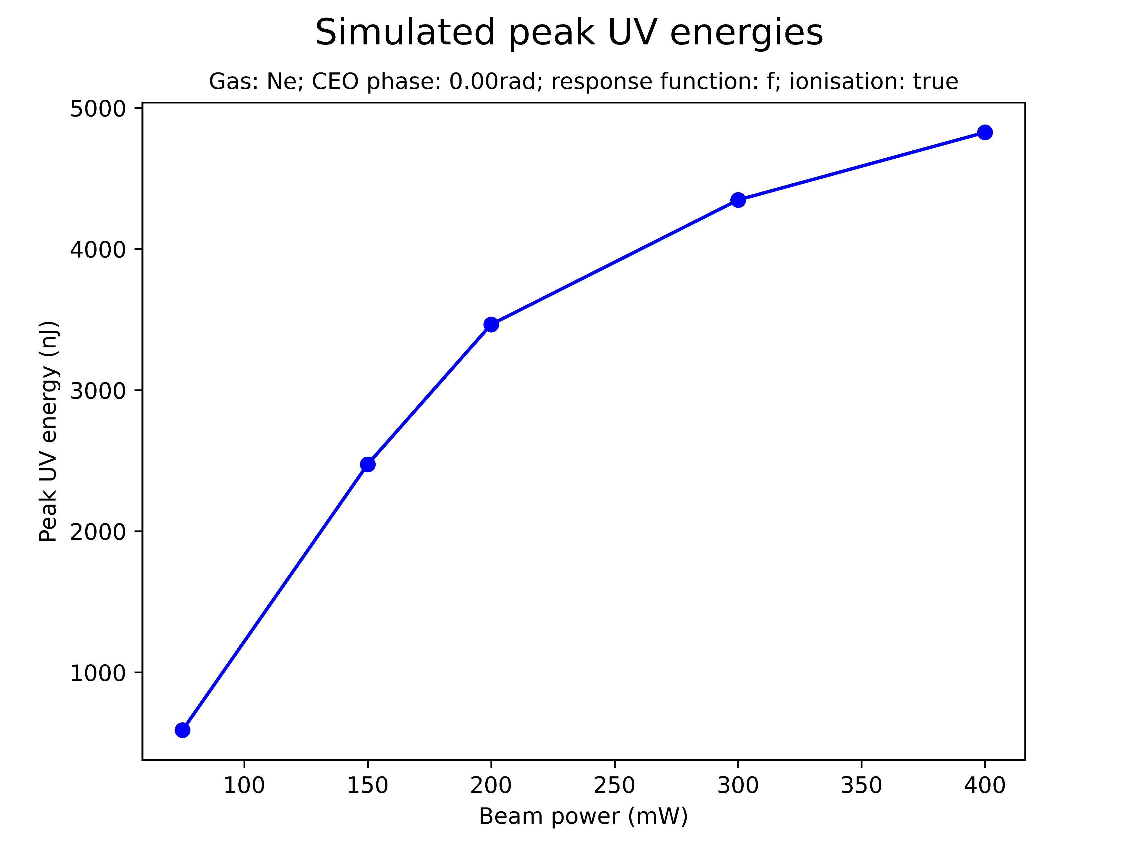
Effect of beam power on saturation

Slide 7
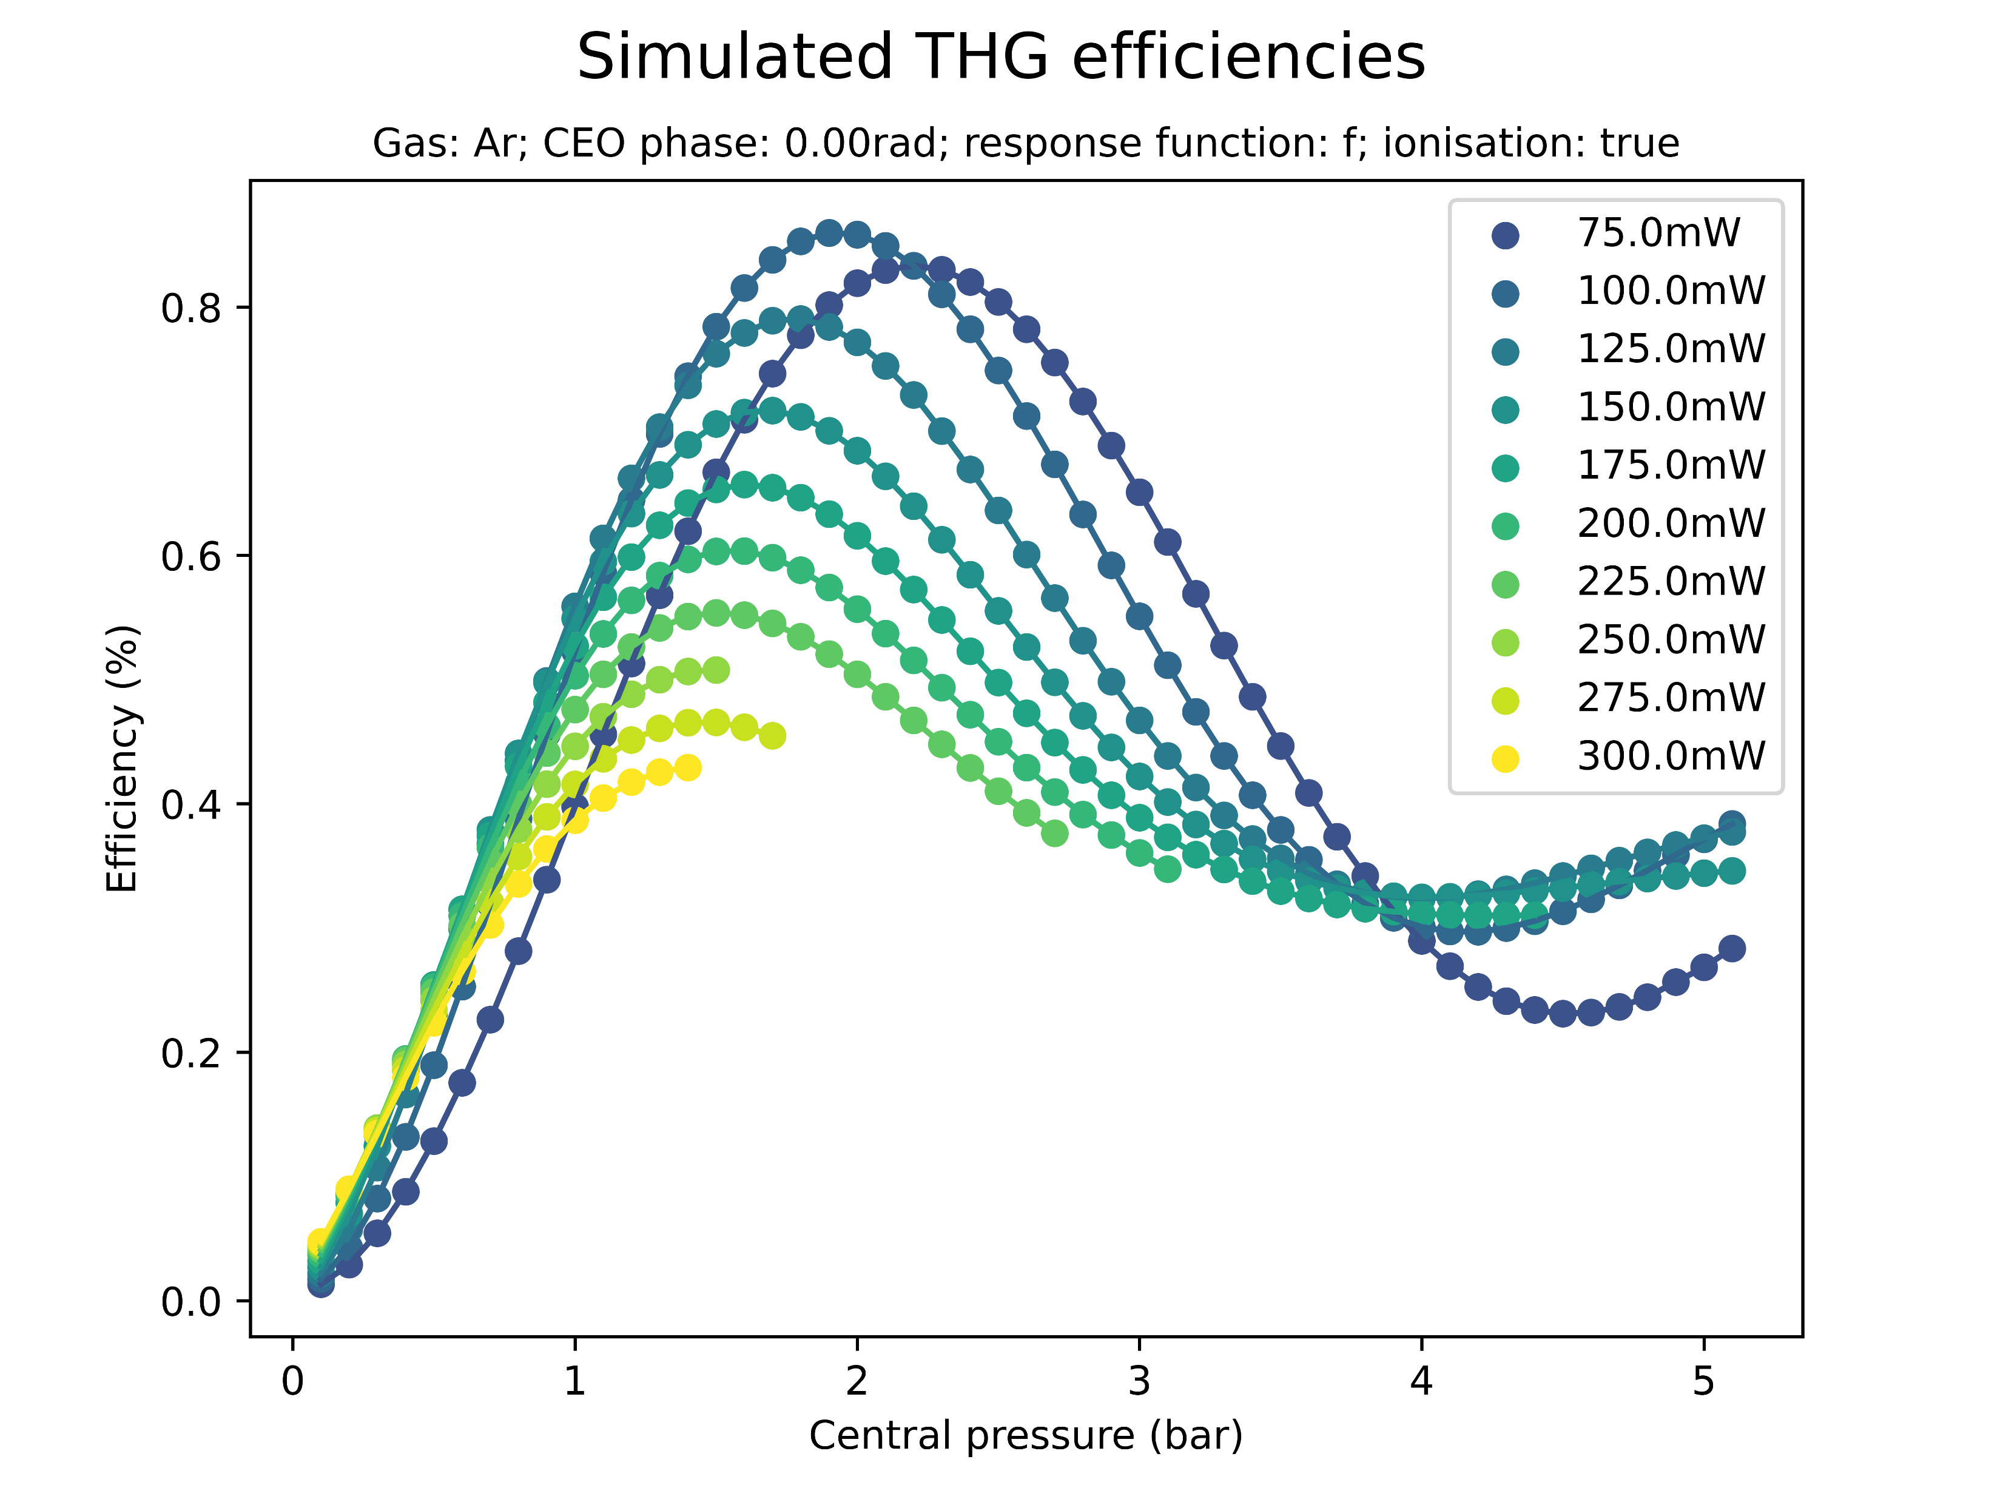
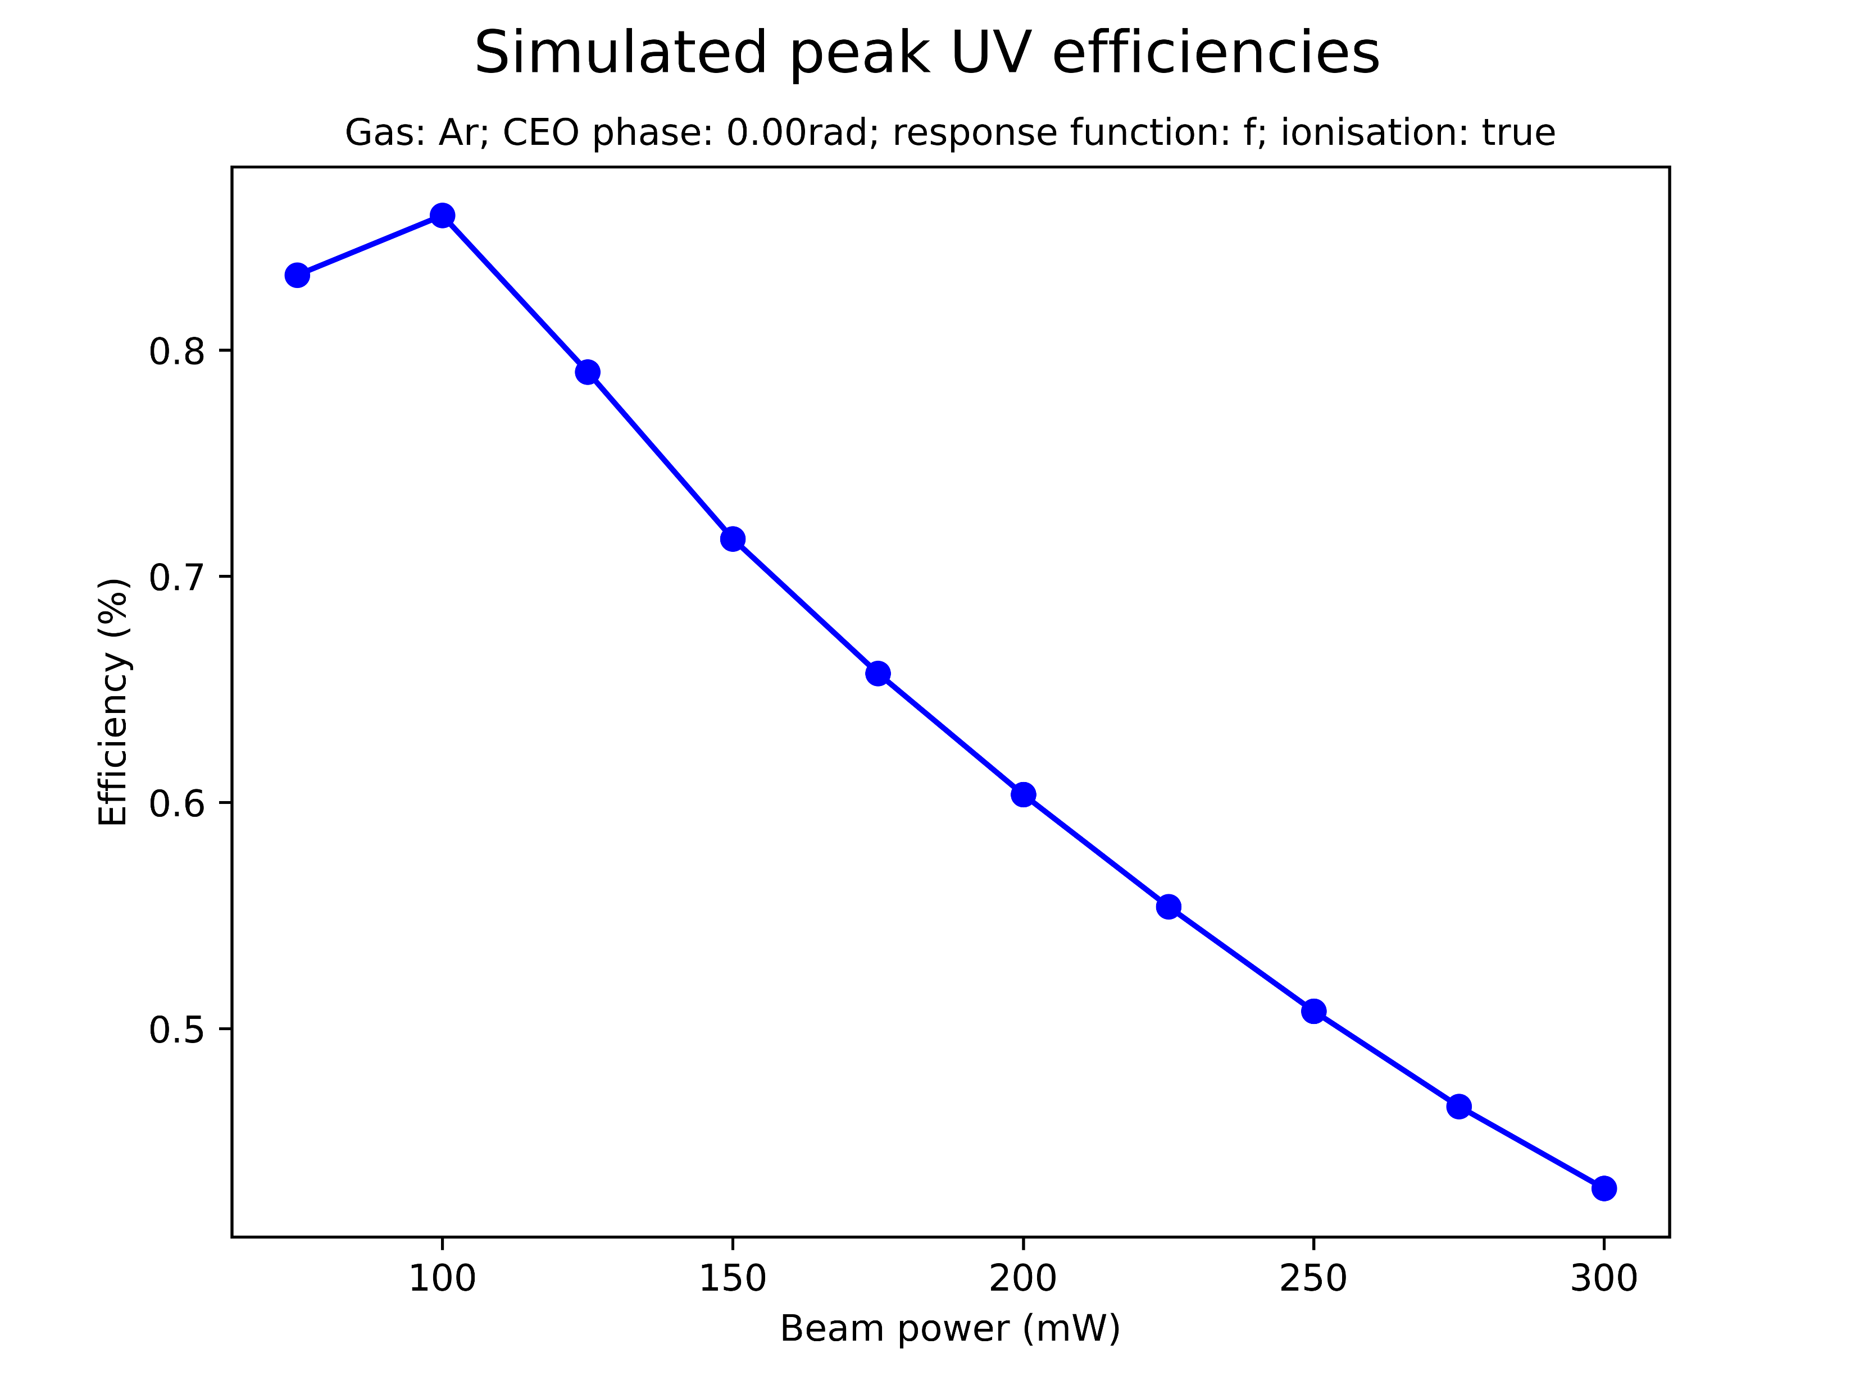
Effect of beam power on saturation

Slide 8
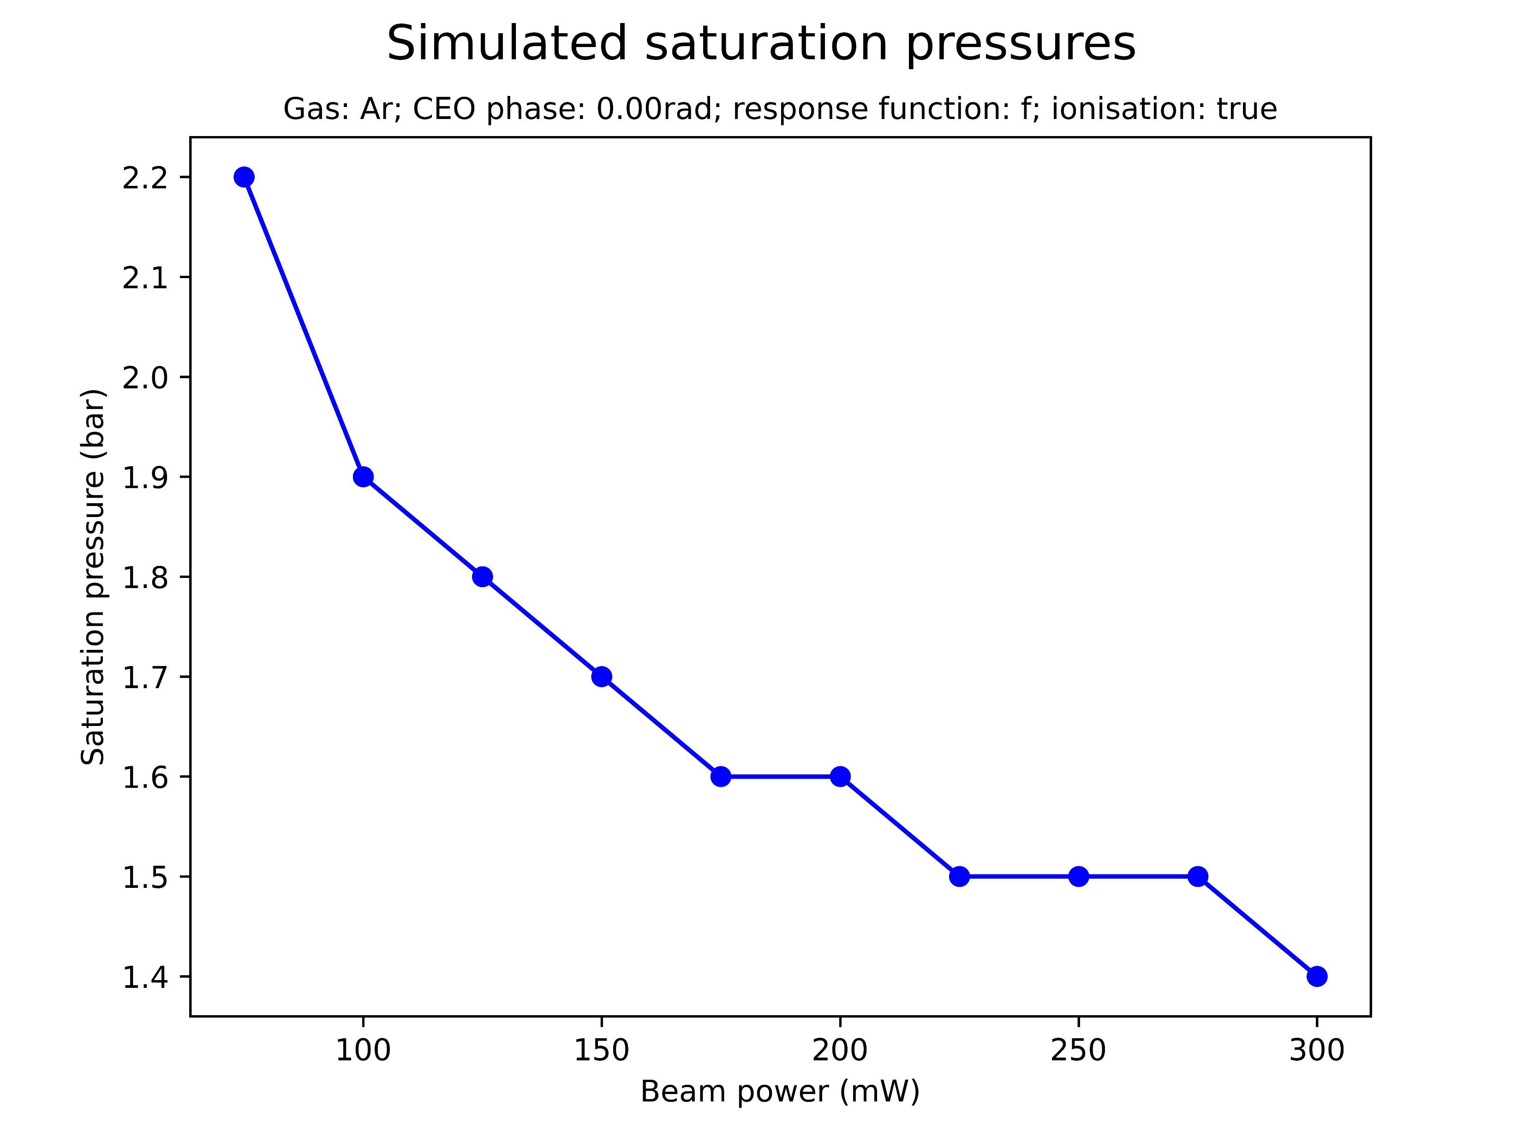
Effect of beam power on saturation
Increasing the beam power increases the peak UV energy and decreases the saturation pressure
The conversion efficiency peaks and then decreases, however
Notably, the peak UV is only increased up to a threshold
Note: same effects observed for Neon (next slide)

Slide 9
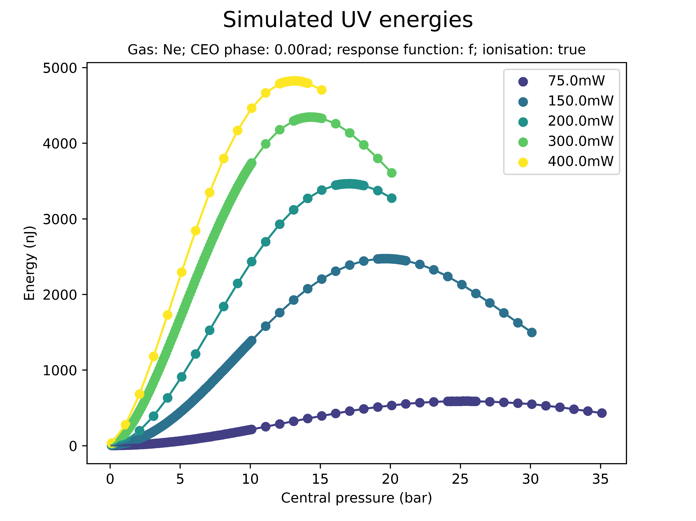
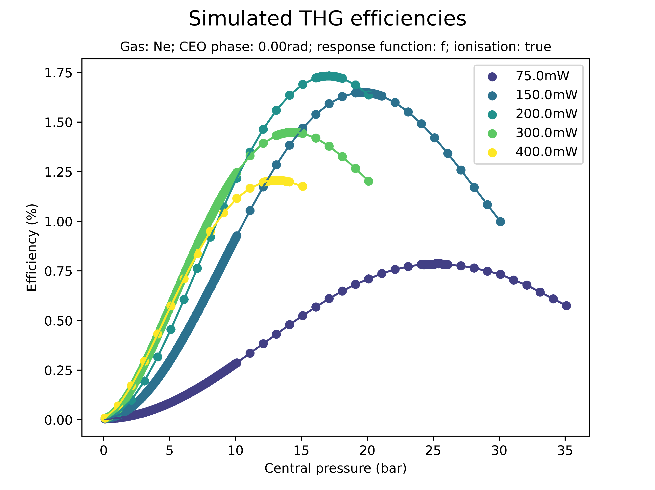
Effect of beam power on saturation (Ne)

Slide 10
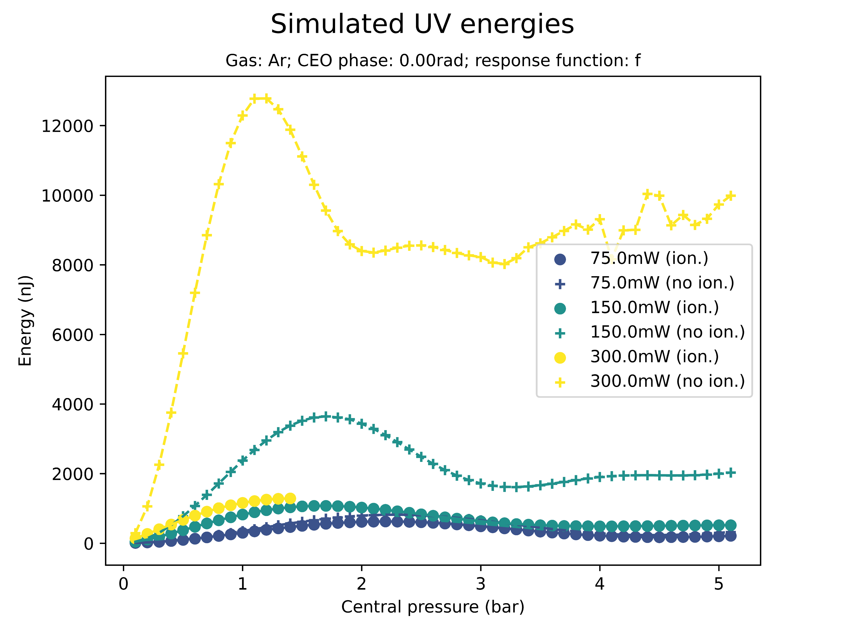
Effect of ionisation on saturation
Saturation sets in even when the ionisation response is turned off
However, at higher pressures, energies, and efficiencies
Again: same thing for Neon

Slide 11
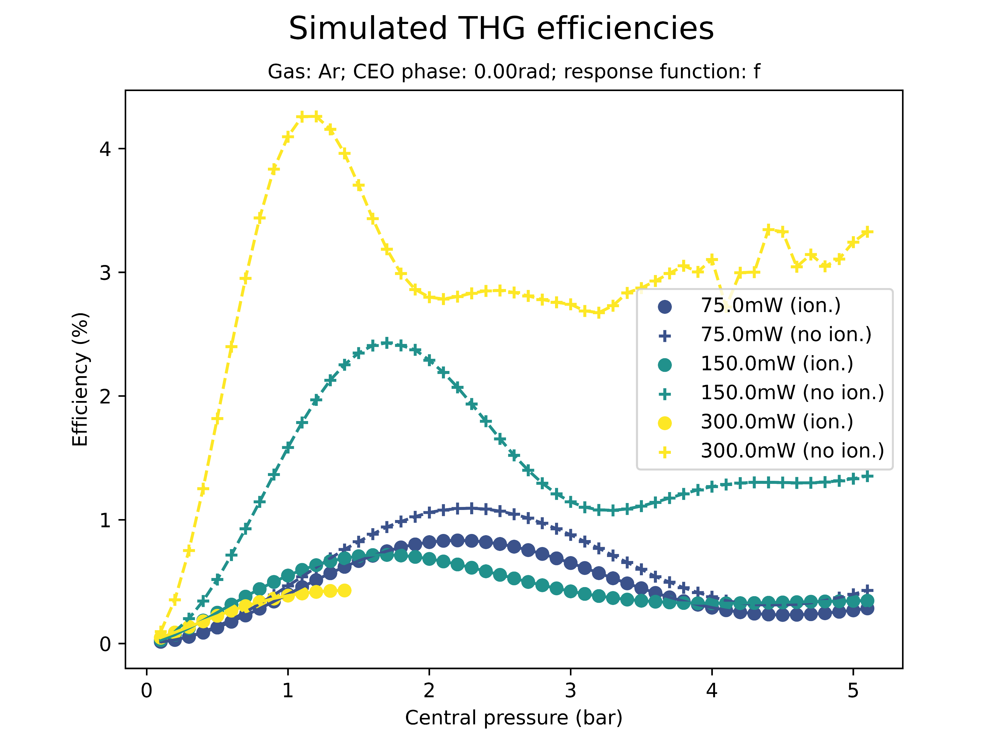
Effect of ionisation on saturation
Saturation sets in even when the ionisation response is turned off
However, at higher pressures, energies, and efficiencies

Slide 12
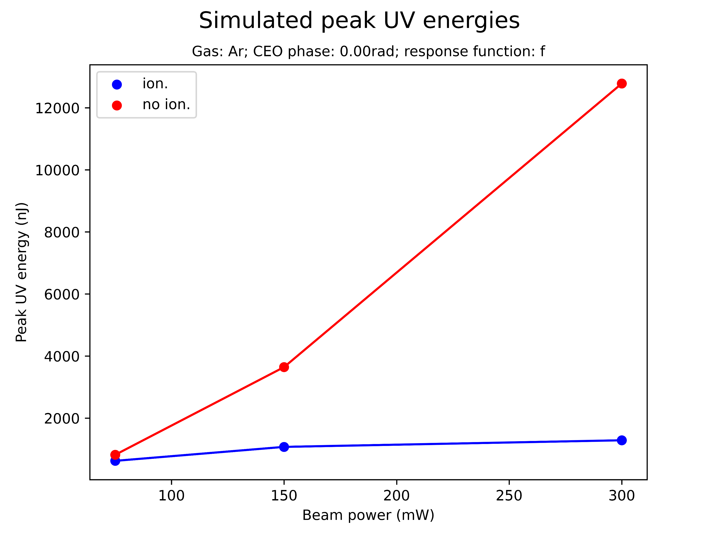
Effect of ionisation on saturation
Saturation sets in even when the ionisation response is turned off
However, at higher pressures, energies, and efficiencies
Not tested yet: threshold for UV peak energy? Peak of conversion efficiency?

Slide 13
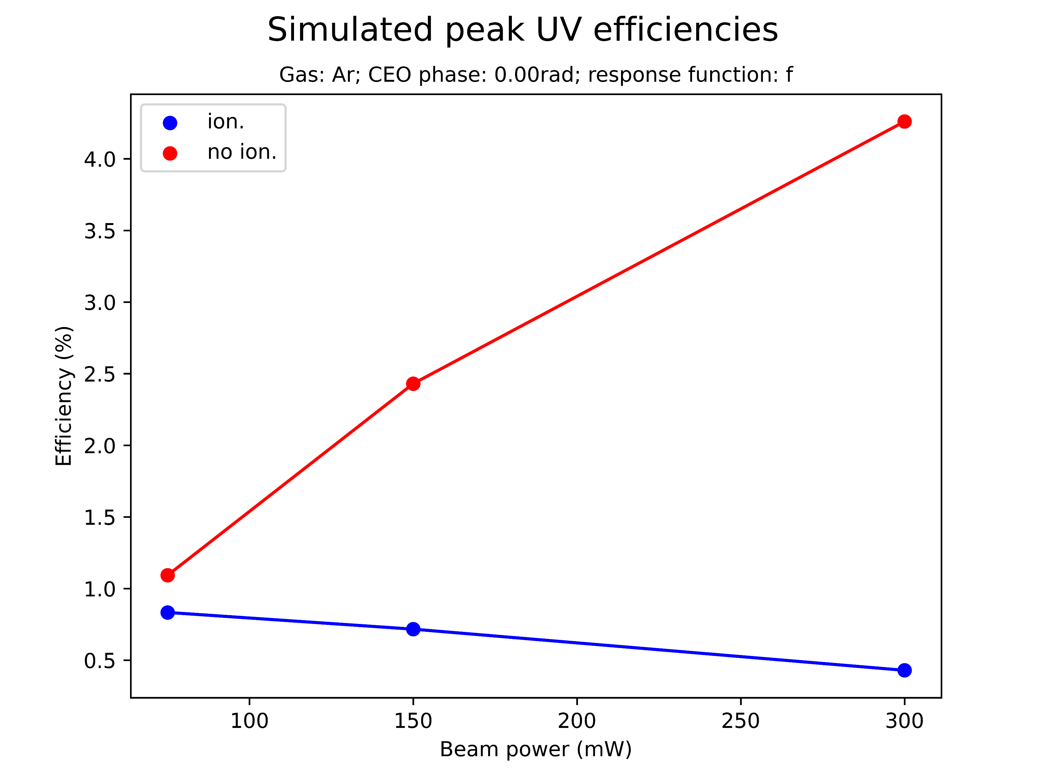
Effect of ionisation on saturation
Saturation sets in even when the ionisation response is turned off
However, at higher pressures, energies, and efficiencies
NOTE: conversion

Slide 14
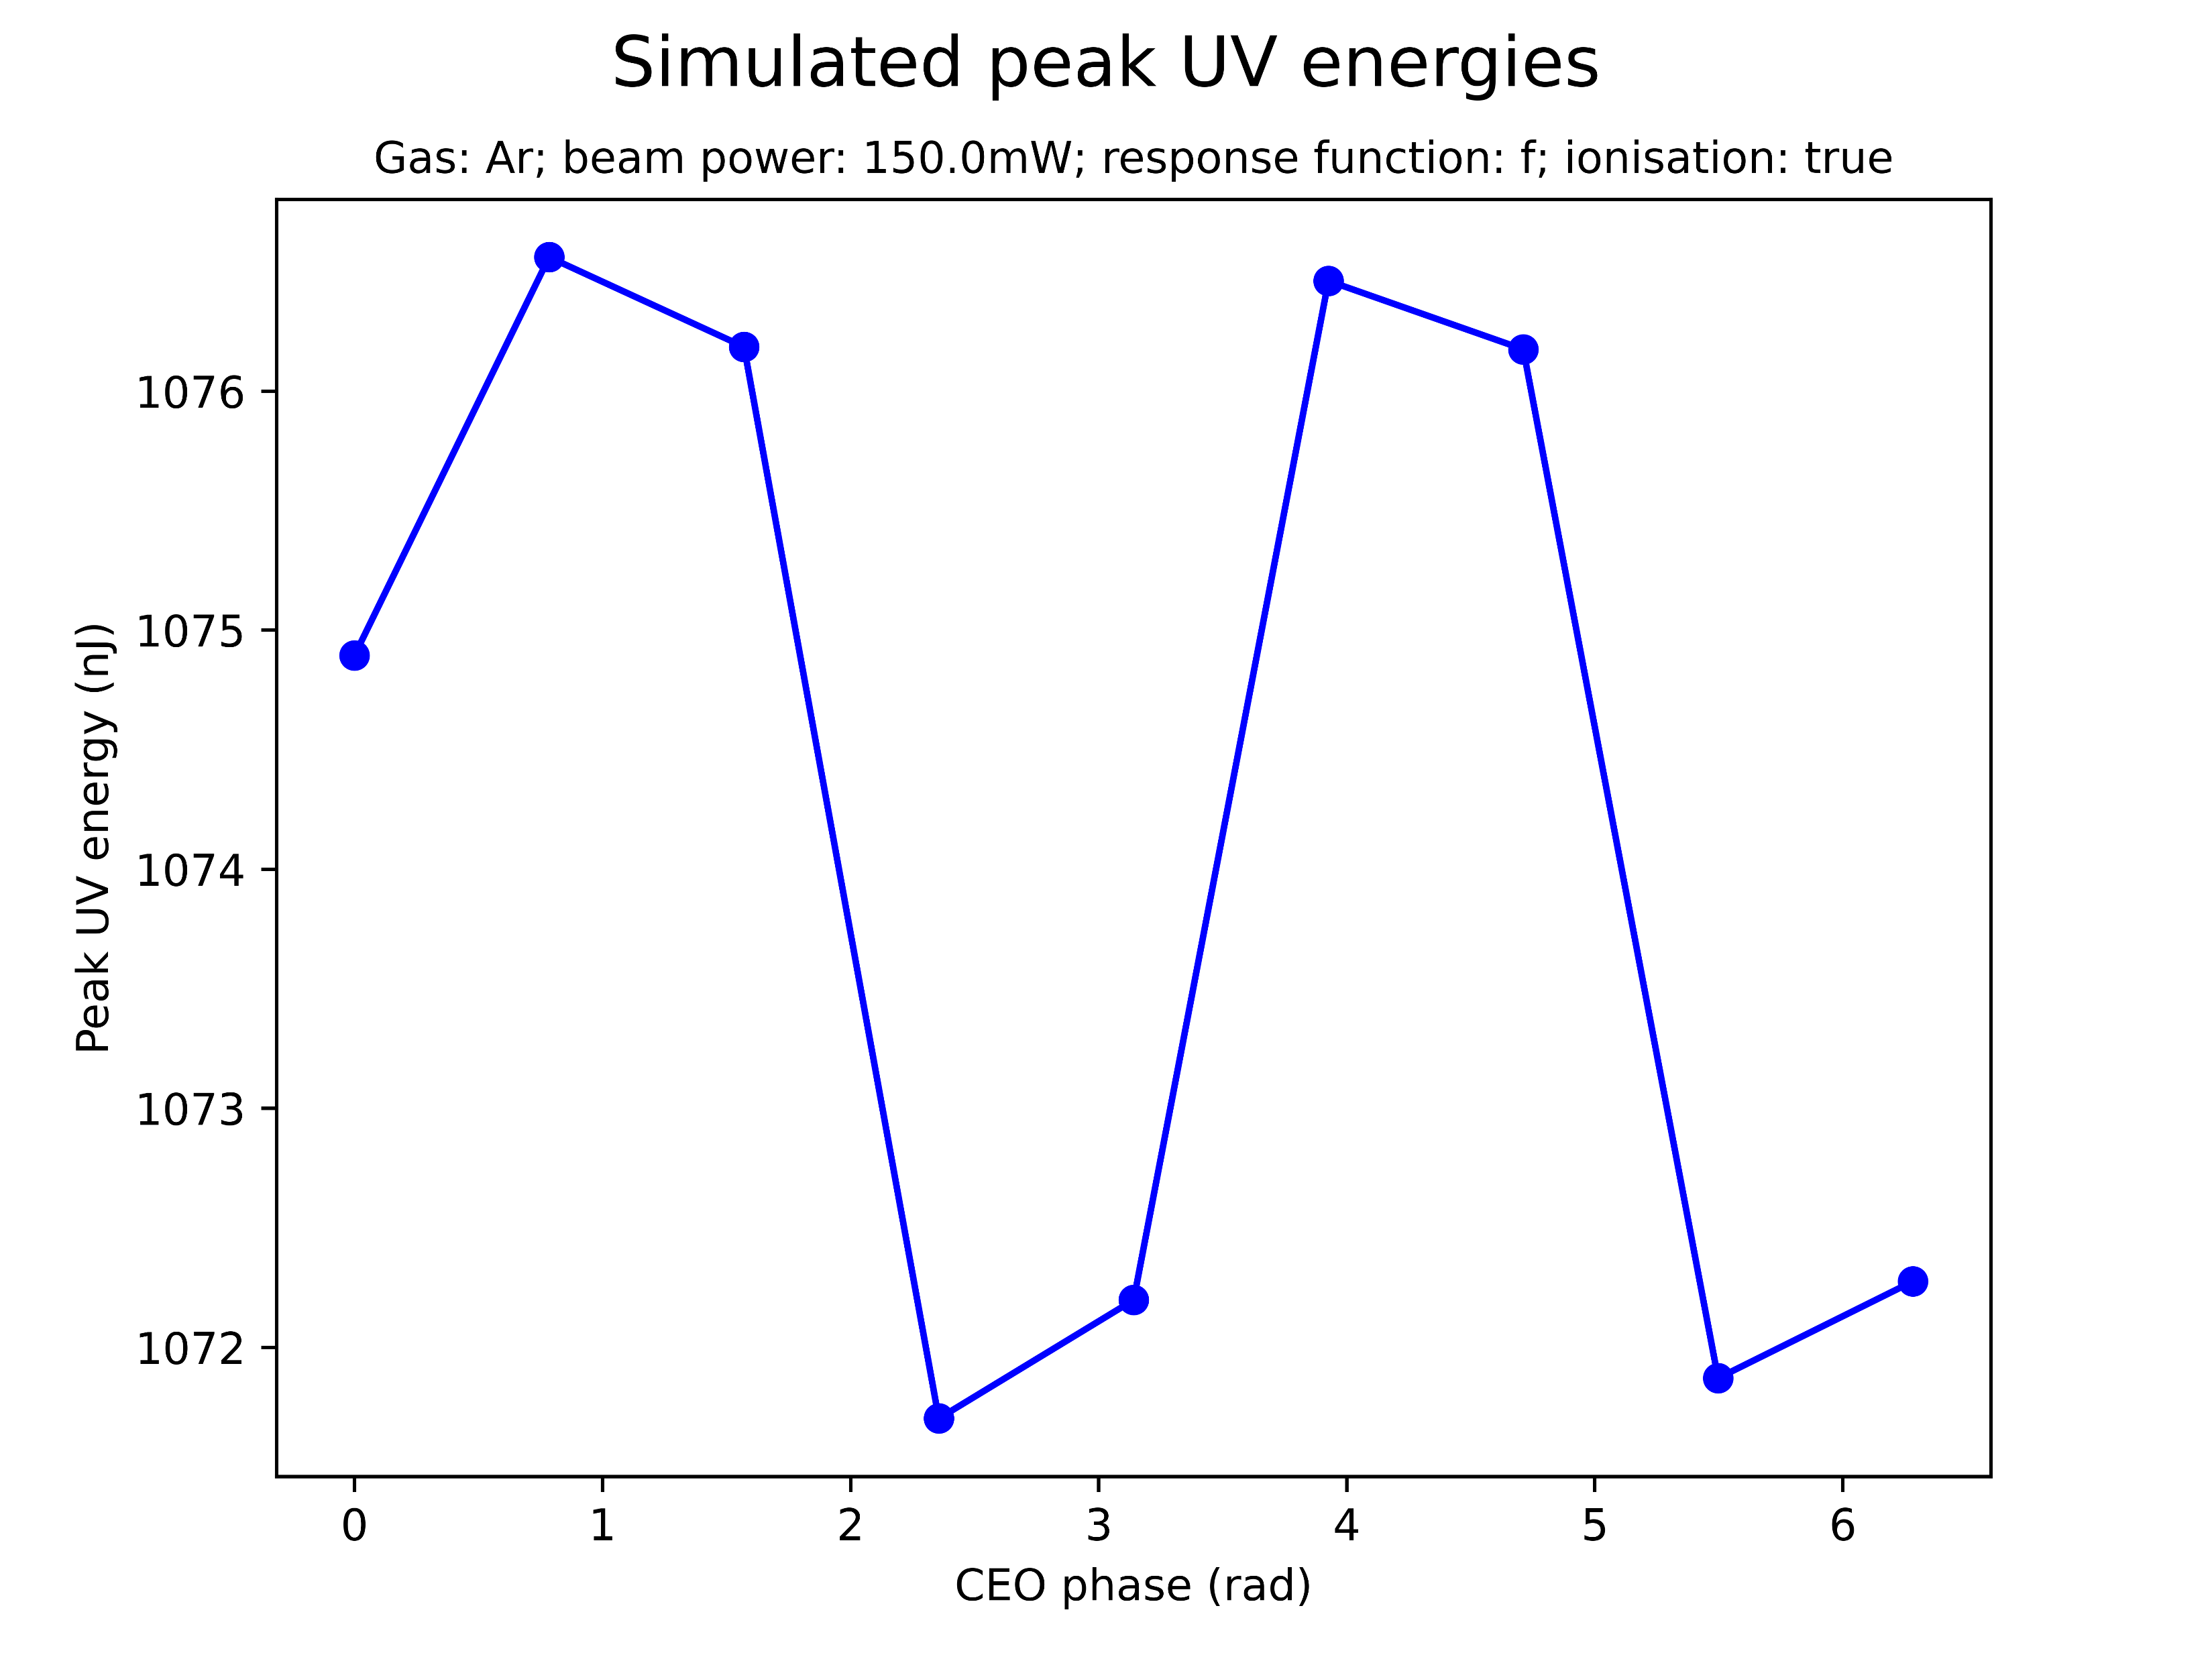
Effect of CEO phase on saturation
Sinusoidal variation of peak UV energy/peak THG efficiency with CEO phase
The amplitude of the oscillation is negligible
CEO phase can be set to zero without significant loss of accuracy
Test this more? (only tested for Ar at 150mW!)

Slide 15
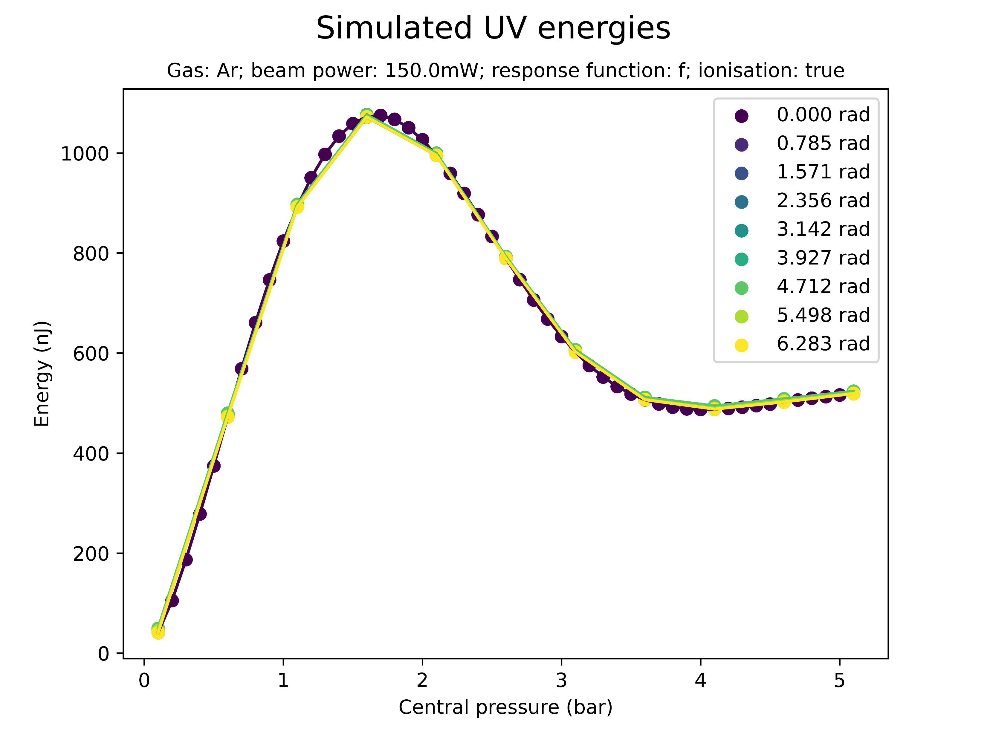
Effect of CEO phase on saturation
Sinusoidal variation of peak UV energy/peak THG efficiency with CEO phase
The amplitude of the oscillation is negligible
CEO phase can be set to zero without significant loss of accuracy
Test this more? (only tested for Ar at 150mW!)

Slide 16
Summary: saturation
How can you explain quantitative differences??
Energy/efficiency not unphysically high but 1 order of magnitude higher than measured!
Pressure is factor 4 larger! Can this be explained due to measurement outside the cell (instead of inside)?

Slide 17
II. SPECTRAL PEAKS

Slide 18
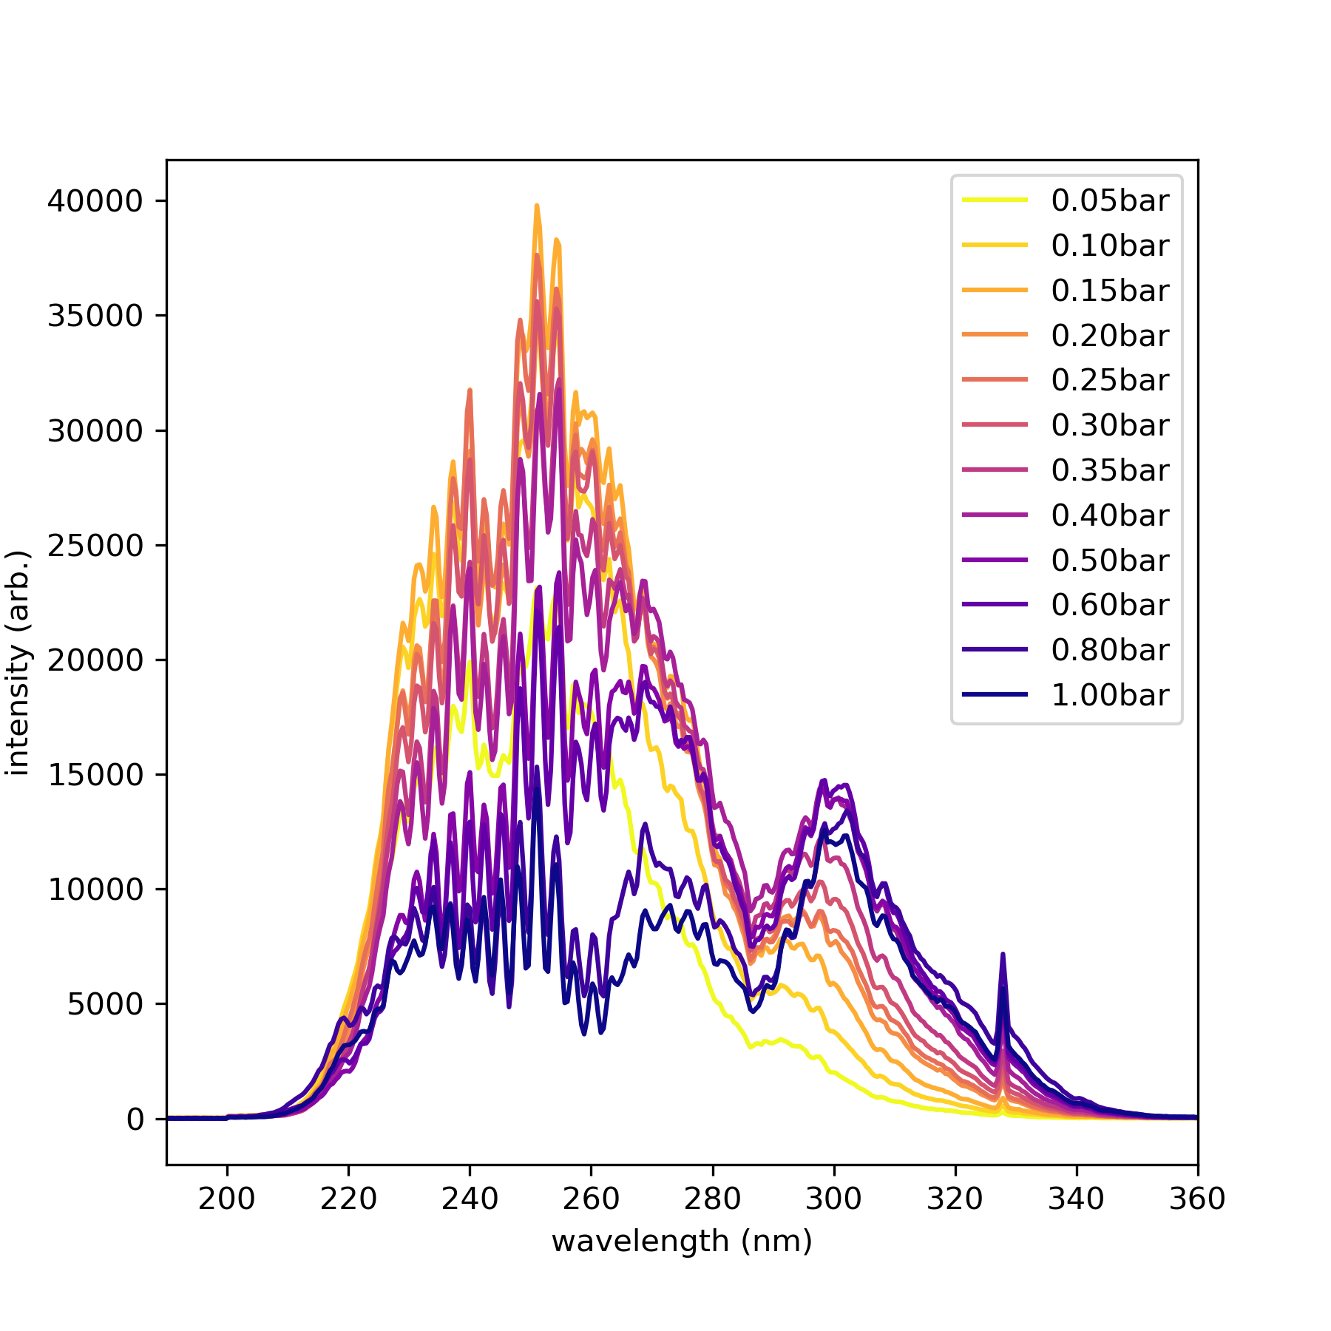
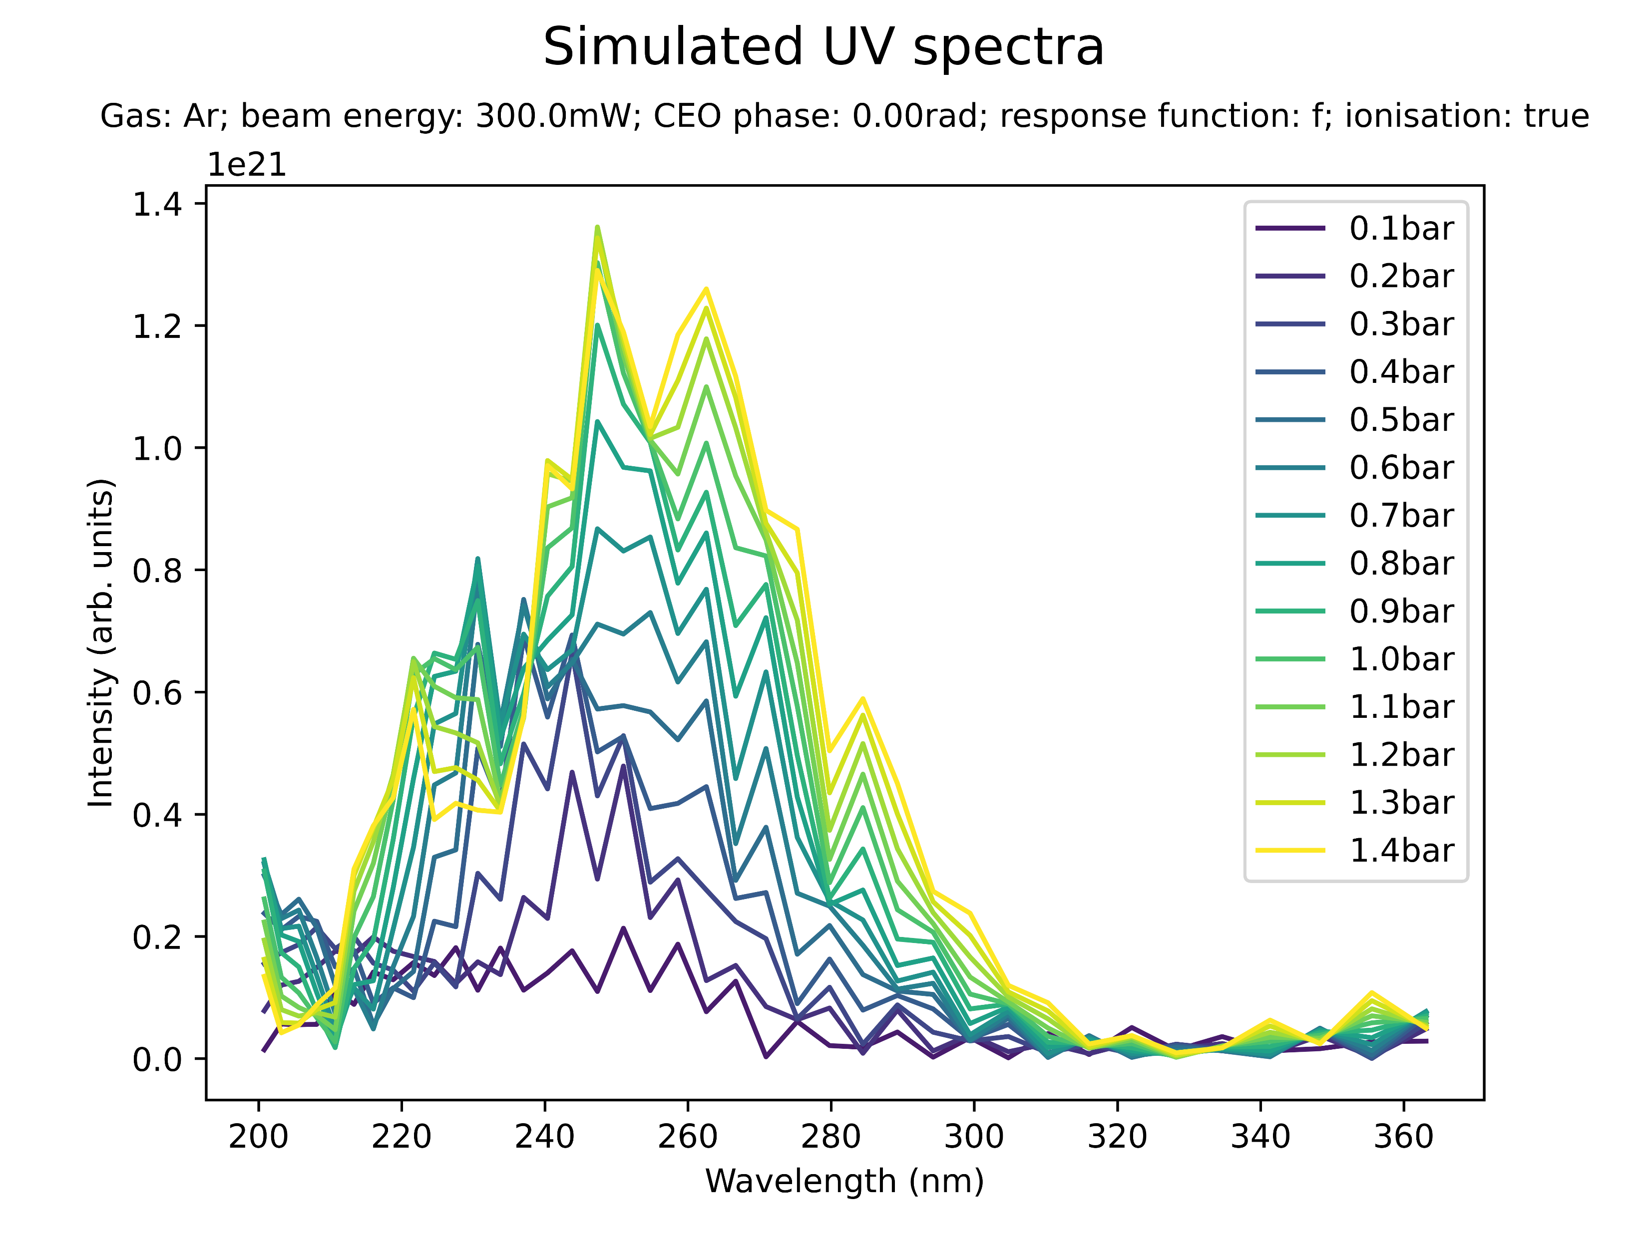

Slide 19
When does second spectral peak appear? (relative to saturation pressure?)
Compare ionisation! Compare beam power? Compare CEO phase?!
Spectrum Ar vs Ne!!

Slide 20
III. BEAM SHAPE

Slide 21
IV. SELF-STEEPENING

